Slide 1
Fundamentals of Information Technology
S.S.NACHIYA
DEPT., OF C.S.,

Slide 2
Microsoft PowerPoint
MS PowerPoint is a program that is included in the Microsoft Office suite. It is used to make presentations for personal and professional purposes.
Information can be displayed using an electronic presentation application. This information is usually presented as a slide show — the data is displayed on a slide that may be viewed on a computer monitor or projected onto a screen using an LCD projector. A presentation might consist of multiple slides that are exhibited one after the other.
The following elements can be added to a Powerpoint slide:
Clip Art
Graphs
Tables
Photographs
Charts
Media Clips
Videos

Slide 3
Uses of PowerPoint Presentation
Education – With e-learning and smart classes being chosen as a common mode of education today, PowerPoint presentations can help in making education more interactive and attract students towards the modified version of studying
Marketing – In the field of marketing, PowerPoint presentations can be extremely important. Using graphs and charts, numbers can be shown more evidently and clearly which may be ignored by the viewer if being read
Business – To invite investors or to show the increase or decrease in profits, MS PowerPoint can be used
Creating Resumes – Digital resumes can be formed using MS PowerPoint. Different patterns, photograph, etc. can be added to the resume
Depicting Growth – Since both graphics and text can be added in a presentation, depicting the growth of a company, business, student’s marks, etc. is easier using PPT

Slide 4
How to open MS PowerPoint
In Windows 7 or below:
Step 1: Go to the program section in the windows start menu.
Step 2: Go to MS Office & click on it. A drop-down list is seen
Step 3: Click on MS PowerPoint & MS PowerPoint window will pop up.
Creating a Presentation
Once your MS PowerPoint Window pops up, you can create & save the file by:
Step 1: Click on the Microsoft button on the top left.

Slide 5
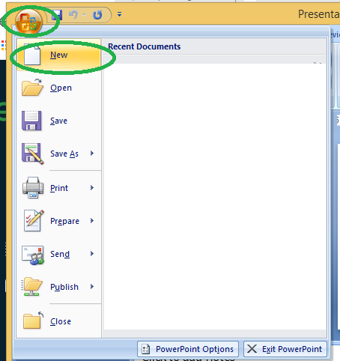
How to open MS PowerPoint

Slide 6
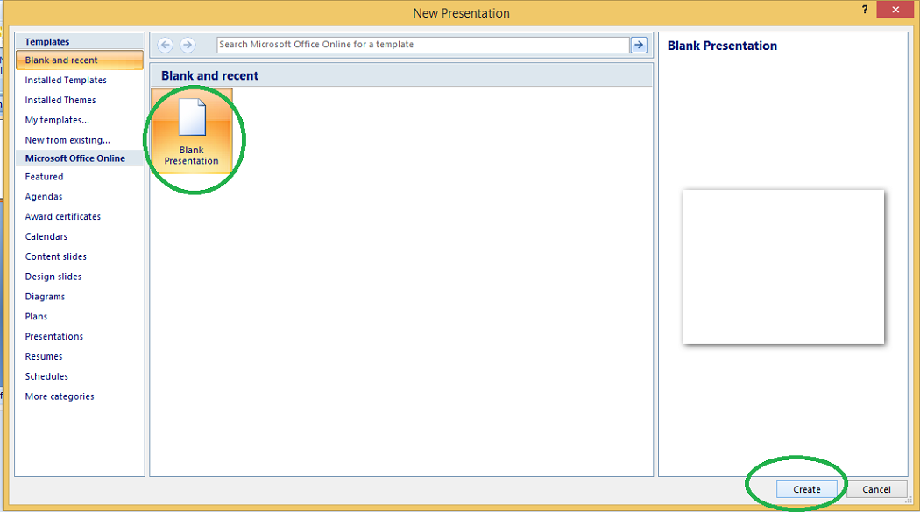
Step 2: Click on new, a new Presentation window will pop up.

Slide 7
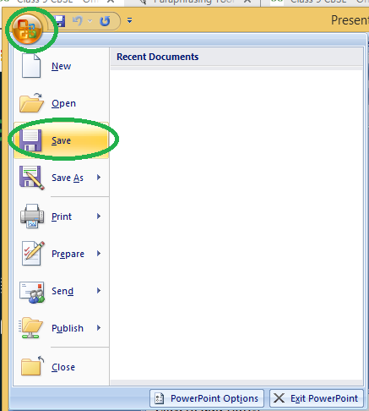
Step 3: Click on Create & a new presentation will be created.
Note: Shortcut for New: Ctrl +n
Saving a Presentation
Once you have created a presentation, it can be easily saved with the help of following steps:
Step 1: Click on the Microsoft icon
Step 2: Click on the Save button

Slide 8
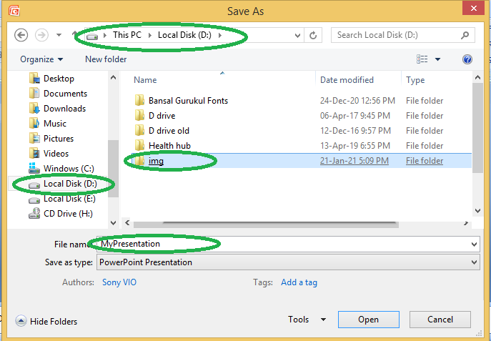
Step 3: A new Window for Save As will pop up.

Slide 9
Step 4: Select the drive (by clicking on it: Example: Local Drive (D)) in which you want to save the presentation.
Then your drive will open up, select the folder in which you want to save the presentation (Example: img folder here) & then give the required name to your presentation (Example: MyPresentation here). Your presentation is created & saved with the provided name.
Note: Shortcut for save: Ctrl + s
Basic Elements of a PowerPoint Window/Slide
You can see various bars in the presentation window. They are:
(i) Title Bar: This shows the name/title given by you to the current presentation. If user do not save the presentation by any name, default name given by MS PowerPoint appears in this bar.
(ii) Menu Bar: Contains menu items like insert, views, design, animations, etc.
(iii) Office Button: MS Office button on the left-most top.
(iv) Formatting Toolbar: Have tools like Bold, Italic, Underline, Font shape & size etc. to format your data.

Slide 10
(v) Zoom Slider: To zoom in or zoom out your presentation.
(vi) Slide Sorter Pane: This allows us to choose which slides will be shown in which sequence during the slide show.
(vii) Notes Pane: This allows us to type notes that we may require later when preparing for the presentation, but they will not be displayed during the slide show.
(viii) View Buttons: Provides different views of your presentation like : normal, slide show & slide sorter.
(ix) Slide Pane: This is where we type, format, and otherwise design the slide.

Slide 11
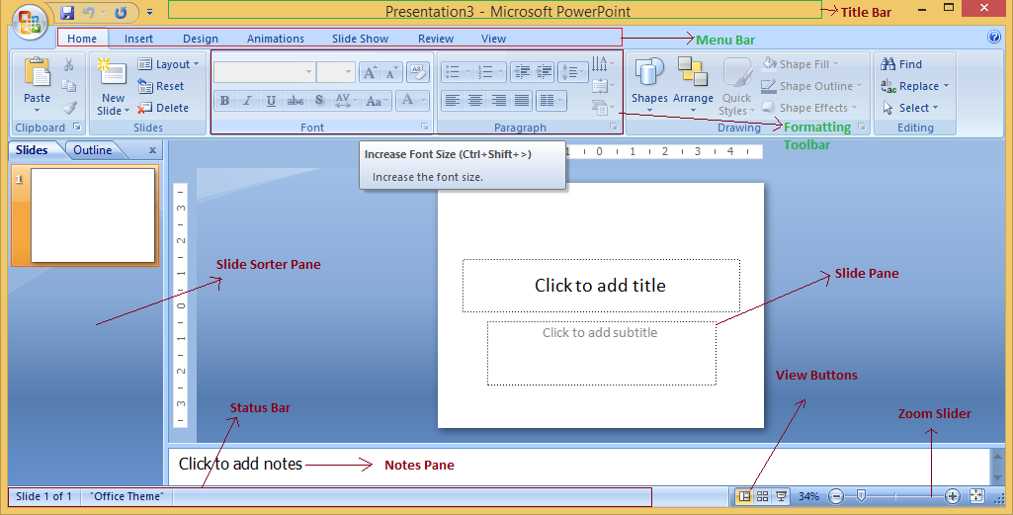

Slide 12
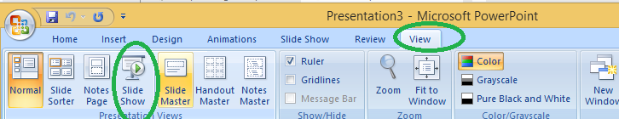
Concept of Slide Shows
After preparing the presentation, it’s time for the slide show. Steps for slide show are:
Step 1. Click on the view Option on the top Menu Toolbar
Step 2. Click on the slide show option.
Step 3. The slide show will start (Press Esc key (escape) to come out of slide show).
Note:Shortcut for the slide show is: F5

Slide 13
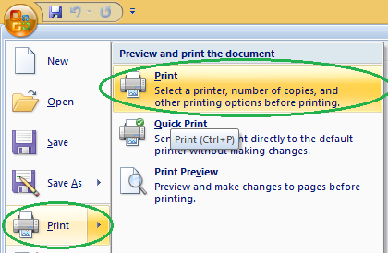
Print a Presentation through an attached printer
Step 1: Click on the Microsoft icon
Step 2: Click On Print & a window for Print & Preview the document will pop up.

Slide 14
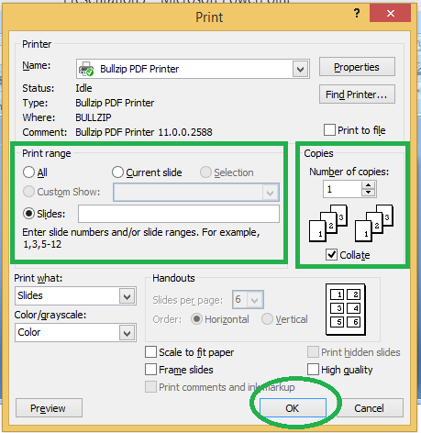
Step 3: Click on Print. Then a window for Print will pop up.

